Slide 1
Machine Learning in Practice I
Lecture 3
Antal Jakovac, 2025

Slide 2
Programming code structure

Slide 3


Code structure
How to organize a (ML) code?
points of view:
  effective code development (also in teams)
  scalability
  extensibility
  easy maintenance

Slide 4
monolith code structure
Original approach: monolith program structure
UI, business logic, data access in one code
coding logic: input data → transformation → resulting data
best fits for imperative/procedural languages (like C, Fortran)
  program state: mutable variables
  program is a chain of commands, changing the state
natural approach → original programming style

Slide 5
monolith code structure
y = 3 #global state variable
def function(x):
x +=y
y+=1 #changes y tacitly
return x
problems:
hard to trace bugs or change code:
  variable change appear in different functions
  frequently hidden state change in procedures
  in a large code intractable structure
functions are specific → not reusable
experience: monolith codes become unmaintainable
(software complexity crisis in the 1970s–80s)
still used for starting a project (MVP)

Slide 6
programming paradigms
class MyClass:
def __init__(self, state):
self.state = state
#change of state is a class method
def rotate(self, angle):
self.state → self.state’(angle)
return self
different type of solutions:
object oriented programming
  data and the corresponding
  procedures are bundled:
  ”objects” of the world
  abstraction:
  hierarchy of classes
  inheritance: classes are reusable
  examples: C++, Java

Slide 7
programming paradigms
counter=0
def impure():
counter+=1 #side effect
return counter
def pure(x):
return x+1 #no side effect
functional programming
  stateless programs, unmutable variables
  functions give back new objects
  (pure functions)
  based on mathematical logic (λ-calculus)
  e.g. λx. x+1 and their application, e.g. (λx. x+1) 5 →6
  basic elemental functions: see next page

Slide 8
programming paradigms
basic elemental functions
  map:
  reduce/fold:
  filter:
  zip:
  compose:
examples: Haskell, Lisp, F#
not popular in the original form, but lot of elements are applied
map (λx. x*2) [1,2,3] → [2,4,6]
fold (+) 0 [1,2,3] → 6
filter even [1,2,3,4] → [2,4]
zip [‘a’,’b’,’c’] [1,2,3] → [(‘a’,1),(‘b’,2),(‘c’,3)]
(compose f g) x → f(g(x))

Slide 9
programming paradigms
mixed (multi-paradigm) languages:
  allow all kind of programming style
  examples: Python, JavaScript, Rust, Swift,
  e.g. Python has map, filter, reduce, based on lists.
  Python supports OOP, classes, inheritance, etc.

Slide 10
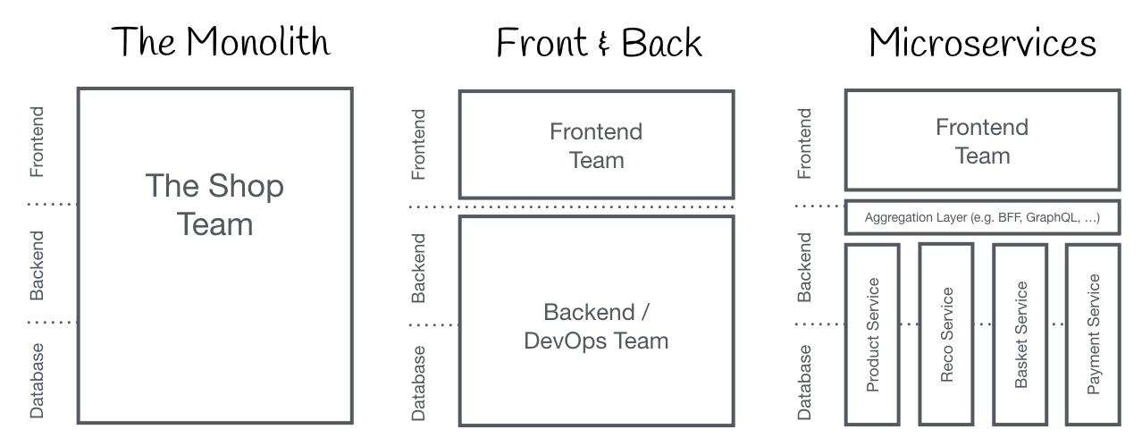
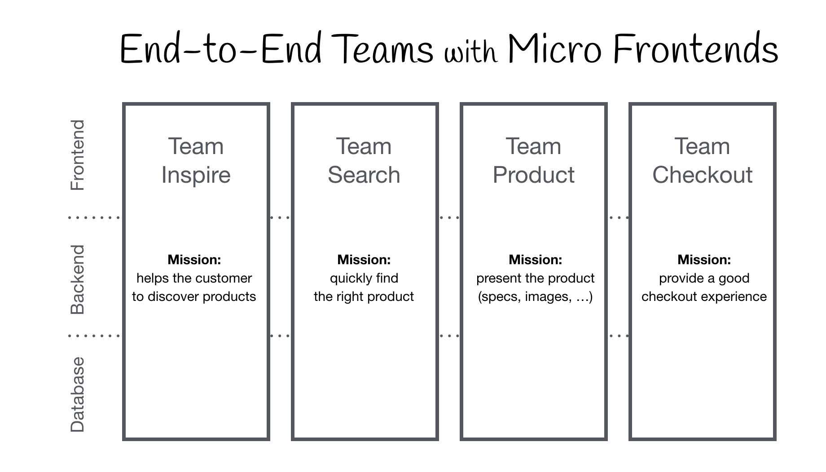
architectures
Other way of deviating from monolithic imperative coding
monolithic structure
frontend+backend
microservices
micro frontend structure
(c.f. https://micro-frontends.org/)

Slide 11
backend + frontend
Backend + frontend
rise of web (1990s) browsers became universal clients
specialized tools for browser programming
(like HTML, CSS, JavaScript)
task solving (backend) + visualization (frontend) separately
  develop separately, different languages, tools
  scale BE and FE separately
  needs interface management → see next page

Slide 12

backend + frontend
functions designed for intra-code communication, can not be applied any more
inter-service communication standards:
  APIs (application programming interface → synchronous)
  queues (message buffer → asynchronous)

Slide 13
backend + frontend
APIs – call server functions (endpoints)
  needs continuously running background processes (web server process), listening to input channels (ports)
  endpoints: well defined input and output formats, usually in json
  communication → REST API: get, put/patch, post, delete
  in Python: Flask, fastAPI
  can be asynchronous, too
#fastAPI snippet
from fastapi import FastAPI
app = FastAPI()
@app.get("/")
def read_root():
return {"message": "Hello ✨"}
-----------------------------
#start service
uvicorn main:app
-----------------------------
#call service
open http://127.0.0.1:8000, or
curl http://127.0.0.1:8000/
results {"message": "Hello ✨"}

Slide 14
backend + frontend
queues: async send message
  message broker runs in background, it stores messages
  worker processes deliver messages for subscribers/consumers
  data plain text or json
  metadata + payload
  in Python: queue + threading
#queue application example
import queue
q = queue.Queue()
#put data to queue
q.put(item)
#read data from queue
item = q.get()
#… process data ...
q.task_done()

Slide 15
microservices
Microservices + frontend
good scaling properties (e.g. web users) → requiring independence of elementary tasks became popular
lot independent, narrowly scoped (micro) services
  separate development (languages, tools, teams), deployment
  separate scaling
  resilience: bugs are confined, not affect the whole system
examples Netflix, Amazon → hype in 2010s

Slide 16
microservices
new challenge: how to organize a lot of services
microservice management:
docker, Kubernetes
#example docker-compose.yml
services:
service1:
build: ./service1
container_name: service1
ports:
- "8001:8000"
service2:
build: ./service2
container_name: service2
ports:
- "8002:8000"
-----------------------------------------------
docker-compose up --build
#example Dockerfile
FROM python:3.12-slim
WORKDIR /app
COPY main.py .
RUN pip install fastapi uvicorn
CMD ["uvicorn", "main:app", "--host", "0.0.0.0", "--port", "8000"]

Slide 17
microservices
new challenge: how to organize a lot of services
CI/CD pipelines:
  continuous improvement
  continuous deployment
  team communication
example: github

Slide 18
microservices
#example .github/workflows/ci.yml
name: CI
on:
push: branches: ["main"]
pull_request: branches: ["main"]
jobs:
build-and-test:
runs-on: ubuntu-latest
steps:
- name: Checkout code
uses: actions/checkout@v4
- name: Set up Python
uses: actions/setup-python@v5
with:
python-version: "3.12"
- name: Install dependencies
run: |
python -m pip install --upgrade pip
pip install -r requirements.txt
pip install pytest
new challenge: how to organize a lot of services
CI/CD pipelines:
  continuous improvement
  continuous deployment
  team communication
example: github

Slide 19
microservices
new challenge: how to organize a lot of services
CI/CD pipelines:
  continuous improvement
  continuous deployment
  team communication
example: github
#practical example: git clone project
git clone https://github.com/ajakovac/ML-in-Practice-I.git
cd ML-in-Practice-I

Slide 20
microservices
despite all advantages microservices have drawbacks
  operational complexity → manage hundreds of services
  network calls → latency, performance issues
  interprocess debugging is hard

Slide 21

microservices
Current trends (2020s → now)
  modular monolith applications
  microservices where they make sense
  functions-as-a-service (FaaS)
    in cloud services like AWS, Azure, Google cloud
    locally they seem like functions
    behave like services when deployed
    run on demand

Slide 22
microservices
#example in AWS
#lambda_function.py
def lambda_handler(event, context):
name = event.get("name", "my_name")
return { "statusCode": 200,
"body": f"Hello, {name}! ✨"}
-------------------------------------------
zip function.zip lambda_function.py
aws lambda create-function \
--function-name helloLambda \
--runtime python3.12 \
--role arn:aws:iam::<YOUR_ACCOUNT_ID>:role/lambda-ex-role \
--handler lambda_function.lambda_handler \
--zip-file fileb://function.zip
--------------------------------------------------
curl -X POST \
-H "Content-Type: application/json" \
-d '{"name": "MLcourse"}' \
https://abcd1234.execute-api.us-east-1.amazonaws.com/default/hello
Current trends (2020s → now)
  modular monolith applications
  microservices where they make sense
  functions-as-a-service (FaaS)
    in cloud services like AWS, Azure, Google cloud
    locally they seem like functions
    behave like services when deployed
    run on demand

Slide 23
ML Code structure
Code infrastructure → software architecture
use few necessary microservices → clear task definition
use lambda for simple services
containerize microservices → portability, environmental stability
use container management → docker (Kubernetes)
use CI/CD management → github or similar

Slide 24
Data management sources, formats

Slide 25
Data management
data sources:
user input (text, image, video, etc.) – often not well formed, errors
system generated (logs, measurements, predictions) – well formed data, easy-to-use
own data, own clients (first-party), other companies, their own clients (second-party), other companies not own clients (third-party – e.g. internet usage, traffic, etc)

Slide 26
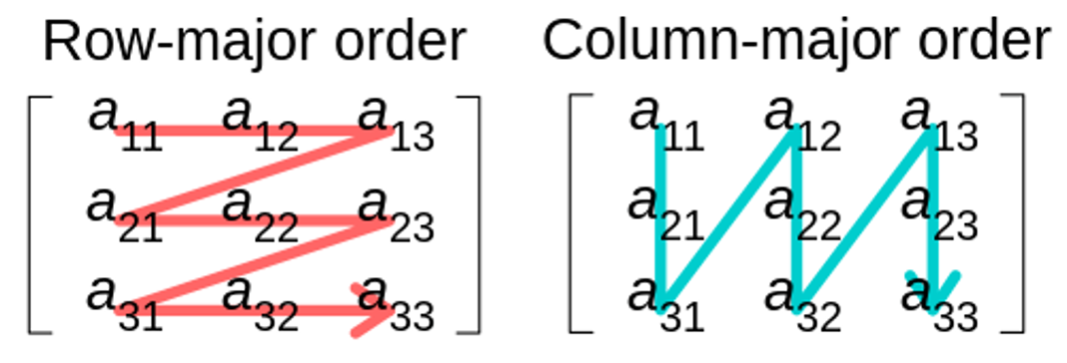
Data management
data formats
CSV (comma separated values)
  text, human readable
  tabular, row-major
  fast to get data belonging to the same example
Parquette
  binary – more compact, but not human readable
  tabular, column major
  fast to get data belonging to the same feature

Slide 27
Data management
#example books.csv
title,author,publisher,year
The Hobbit,J.R.R. Tolkien,George Allen & Unwin,1937
The Fellowship of the Ring,J.R.R. Tolkien,George Allen & Unwin,1954
Nineteen Eighty-Four,George Orwell,Secker & Warburg,1949
Brave New World,Aldous Huxley,Chatto & Windus,1932
The Catcher in the Rye,J.D. Salinger,”Little, Brown and Company”,1951
-------------------------------------------
#read data using pandas
import pandas as pd
df = pd.read_csv("books.csv")
print(df)
-------------------------------------------
#output
title author publisher year
0 The Hobbit J.R.R. Tolkien George Allen & Unwin 1937
1 The Fellowship of the Ring J.R.R. Tolkien George Allen & Unwin 1954
2 Nineteen Eighty-Four George Orwell Secker & Warburg 1949
3 Brave New World Aldous Huxley Chatto & Windus 1932
4 The Catcher in the Rye J.D. Salinger Little, Brown and Company 1951
data formats
CSV (comma separated values)
  text, human readable
  tabular, row-major
  fast to get data belonging to the same example
Parquette
  binary – more compact, but not human readable
  tabular, column major
  fast to get data belonging to the same feature

Slide 28
Data management
data formats
CSV (comma separated values)
  text, human readable
  tabular, row-major
  fast to get data belonging to the same example
Parquette
  binary – more compact, but not human readable
  tabular, column major
  fast to get data belonging to the same feature
#store in parquette – needs fastparquet to be installed
df.to_parquet("books.parquet", engine="fastparquet", index=False)
--------------------------
#store in parquette – needs fastparquet to be installed
df_parquet = pd.read_parquet("books.parquet", engine="fastparquet")

Slide 29
Data management
data formats:
JSON (JavaScript Object Notation) → today’s standard
  hierarchical structure
  text, human readable
  key-value pairs
  in Python: dict
  supported by all languages

Slide 30
Data management
#example books.json
[
{
"title": "The Hobbit",
"author": "J.R.R. Tolkien",
"publisher": "George Allen & Unwin",
"year": 1937
},
{
"title": "The Fellowship of the Ring",
"author": "J.R.R. Tolkien",
"publisher": "George Allen & Unwin",
"year": 1954
},…
]
---------------------------------------------
#read with pandas
df = pd.read_json("books.json")
data formats:
JSON (JavaScript Object Notation) → today’s standard
  hierarchical structure
  text, human readable
  key-value pairs
  in Python: dict
  supported by all languages

Slide 31
END OF LECTURE 3

